Slide 1
Power Sub-Mesh Construction in Multiple Power Domain Design
Chien-Pang Lu, Iris Hui-Ru Jiang, Chung-Ching Peng
Intel Cooperation
National Taiwan University
Presenter : Min-Feng Hsieh
Advisor : Ting-Chi Wang

Slide 2
Outline
Introduction
Preliminaries
Proposed Algorithm
StWL Optimization in Global Placement
StWL Optimization in Cell Refinement
Experimental Result

Slide 3
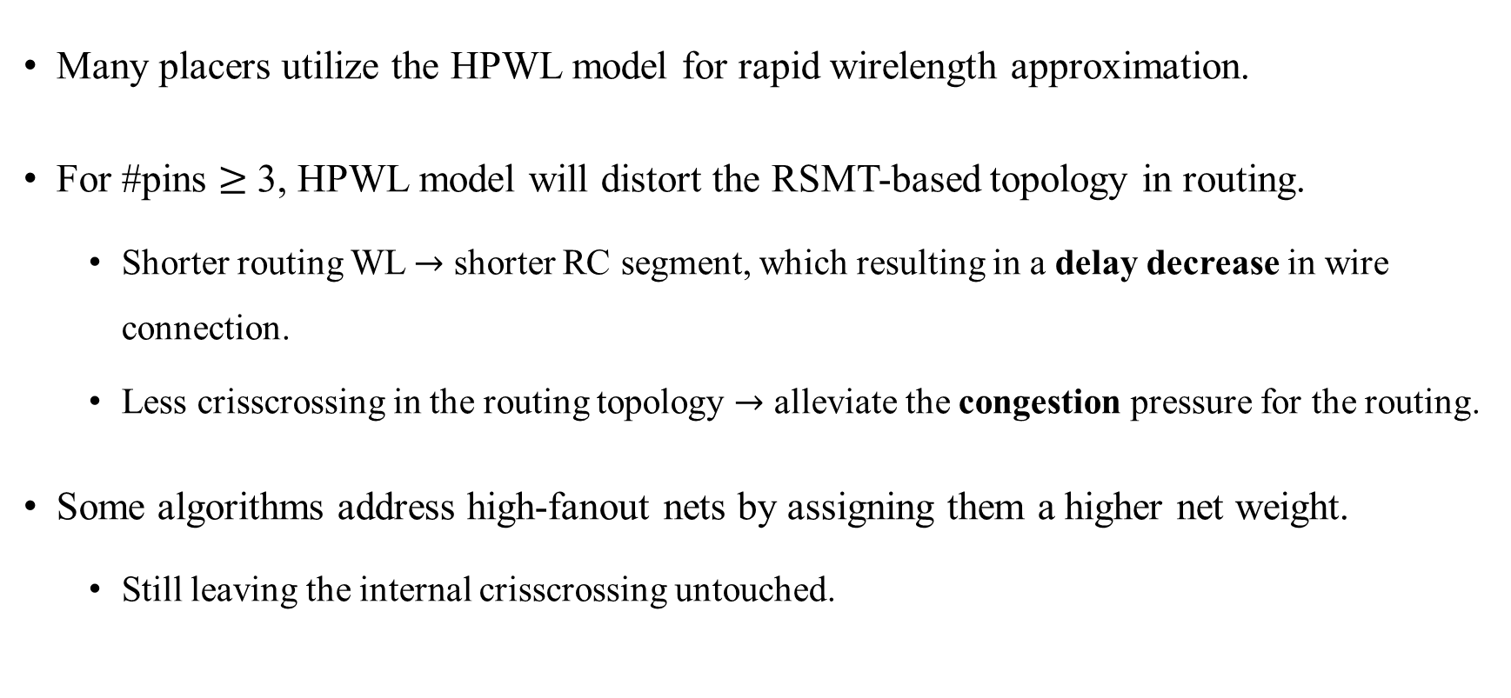
Introduction
Many placers utilize the HPWL model for rapid wirelength approximation.
For #pins $≥$ 3, HPWL model will distort the RSMT-based topology in routing.
Shorter routing WL $→$ shorter RC segment, which resulting in a delay decrease in wire connection.
Less crisscrossing in the routing topology $→$ alleviate the congestion pressure for the routing.
Some algorithms address high-fanout nets by assigning them a higher net weight.
Still leaving the internal crisscrossing untouched.

Slide 4
Preliminaries
Power Domain
A collection of cells that use the same power supply during normal operation.
Can be switched on or off at the same time.
There are numerous multiple power domain cells
Always-on buffers/inverters, retention flip-flops, isolation cells.
There are 2 types of power source for a cross domain cell
Direct supply: primary power mesh directly supplies power to the cross domain cells.
Indirect supply: power gating cell (MTCMOS), level shifter.

Slide 5

Preliminaries
Static IR drop:
Measure the weakness of the overall power delivery network.
$V_{static_drop}= I_{avg} × R_{wire}$
$I_{avg}:$ The average current drawn from PDN under average switching rate.
$R_{wire}:$ Effective resistance from the power source to the location of interest in the layout.

Slide 6
Thank you for listening!

